Slide 1



Predicting Credit Risk: A Two-Stage Hybrid Model For Reducing False Alarm Rate
Yash Sinojia (A00268852)
M.S. in Data Analytics, Thesis

Slide 2
Research Question
Which type of clustering-classification hybrid model can provide the best implementation to minimize the false alarm rate for the analysis of a given credit risk scenario?
Research Objectives
1. To gather the required data on individual socio-economical and demographical factors that may lead to credit risk.
2. Understanding the data, rectifying any issues, and utilizing it for machine learning models.
3. Preparing the features and data required for machine learning analyses.
4. Building two-staged clustering and classification hybrid models feasible for the credit risk scenario.
5. Identifying the best hybrid model by evaluating the model outcomes.

Slide 3
Hybrid Model
Feature Extraction
Stage 1: Clustering
Numerical variables only
Log transform
Elbow method
Stage 2: Classification
Numerical and categorical variables
Cluster labels as a feature
PCA
Random Forest
XGBoost
K Means
SVC
Logistic Regression

Slide 4
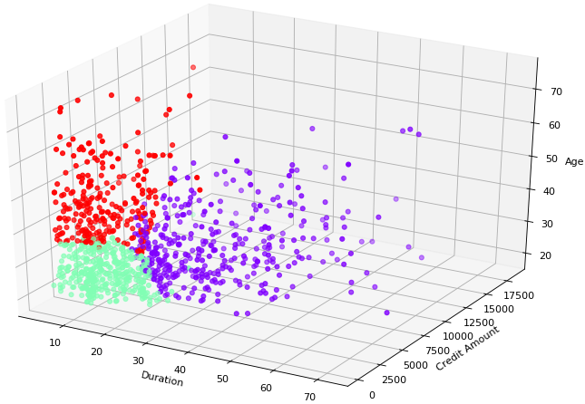
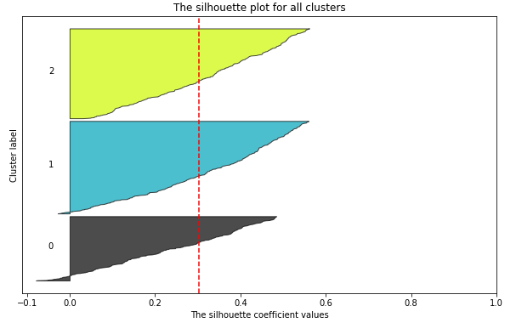
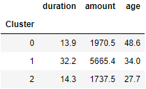
Clustered Data

Slide 5
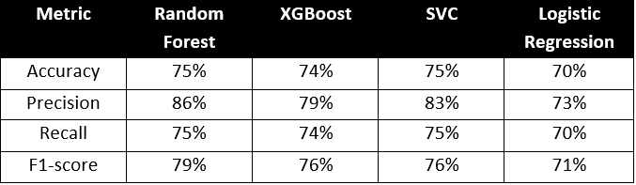
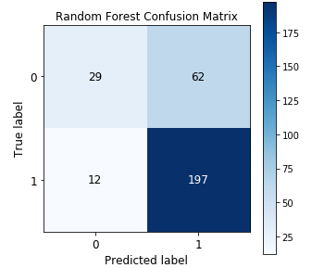
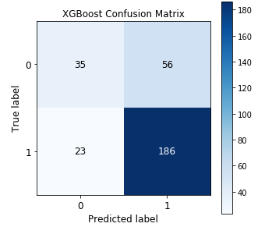
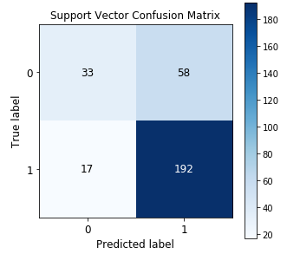
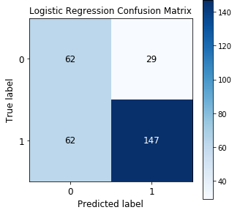
Classification Results

Slide 6
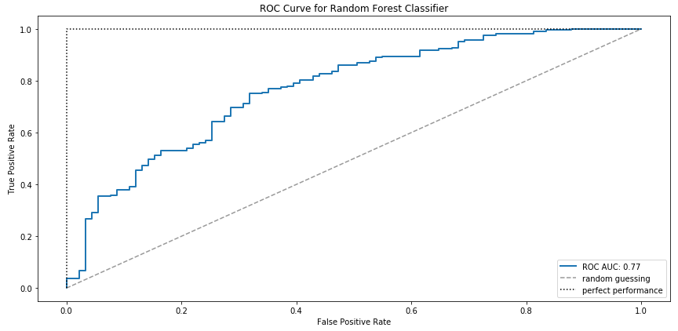
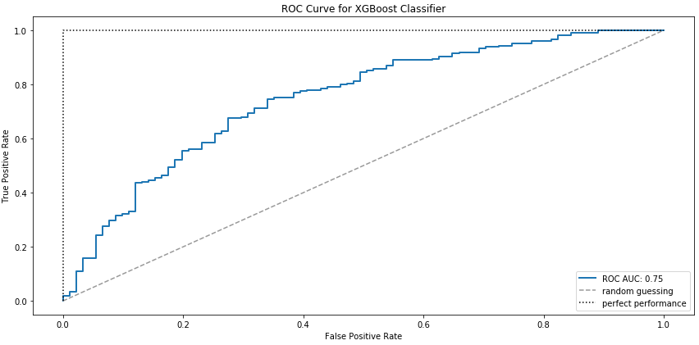
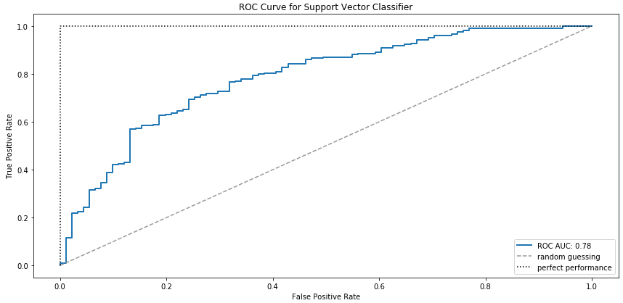
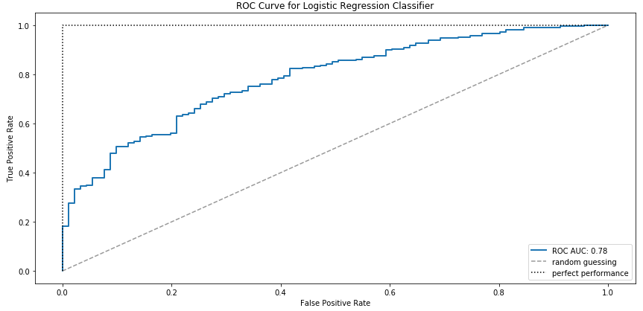

Slide 7
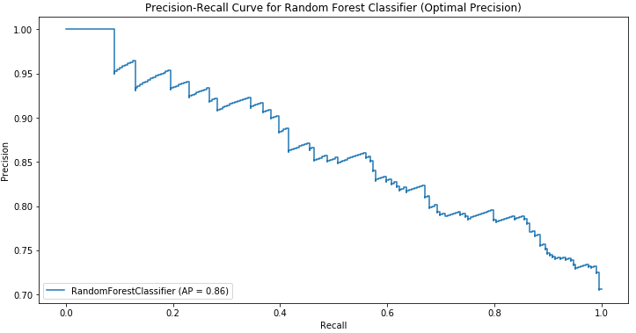
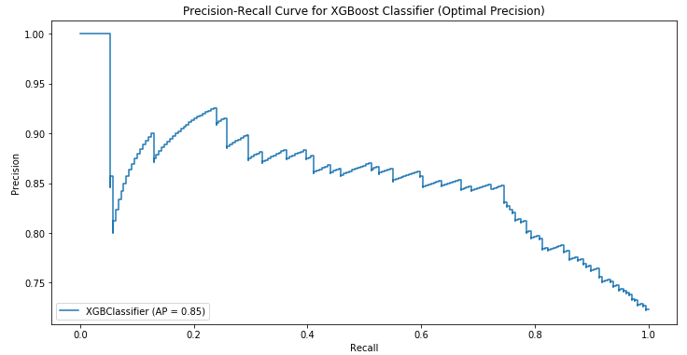
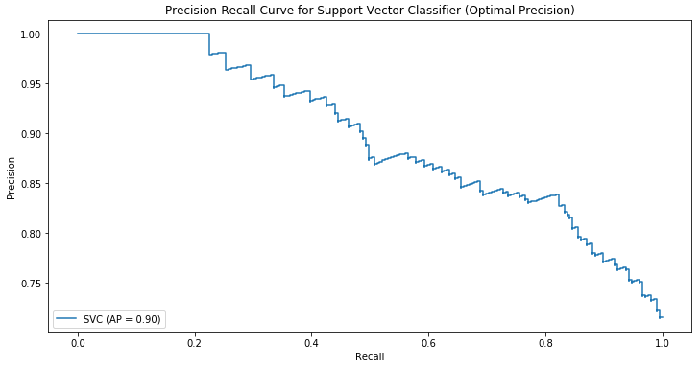
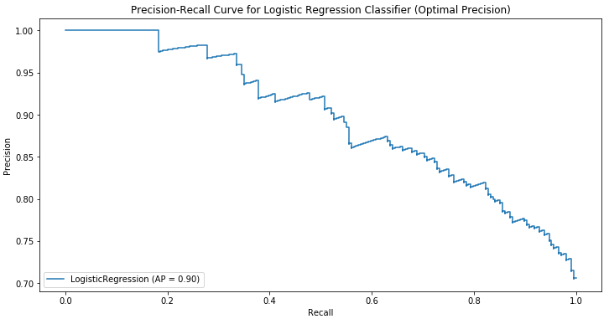

Slide 8
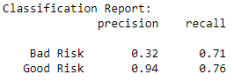
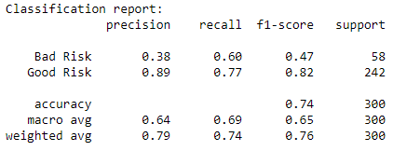
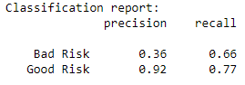
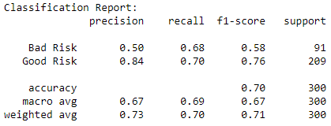
Classification on target labels
Random Forest
XGBoost
SVC
Logistic Regression

Slide 9
